Slide 1


Understanding Flu Vaccine Hesitancy: A Machine Learning Approach for Informed Public Health Intervention

Slide 2

01
Business Overview
Content
Outline
02
Problem Statement
03
Data modelling
Topics for discussion
04
Model interpretation
05
Conclusions
06
Recommendations

Slide 3

BUSINESS OVERVIEW
This project is aimed to provide insights into predicting seasonal flu vaccination status accurately and identifying key factors influencing vaccination decisions. The results from this study could contribute to optimizing pro-vaccination efforts and targeting specific subgroups to maximize the benefits of herd immunity, particularly in the context of seasonal flu.

Slide 4
PROBLEM STATEMENT
Vaccination reduces co-infection risk and eases healthcare strain, yet vaccine skepticism is causing immunization rates to decline.
Flu vaccine hesitancy is a major concern, hindering efforts against seasonal flu outbreaks. Despite the flu causing millions of hospitalizations and 52,000 deaths annually, only 51.4% received the vaccine in the 2021-22 season.
Vaccine hesitancy leads to disease spread, strains healthcare, and may cause co-infections, causing economic burdens and disrupting daily life.
Prompt flu vaccination is crucial, especially during fall and winter when flu spreads
Flu vaccine hesitancy is driven by factors like misinformation, safety fears and beliefs. Understanding these helps design effective interventions.

Slide 5


MAIN OBJECTIVE
To utilize machine learning to understand flu vaccine hesitancy by predicting the likelihood of individuals receiving their seasonal flu vaccines.

Slide 6

Specific Objectives
To identify socio-cultural, psychological, and communication-related factors that affect flu vaccine hesitancy.
Develop a predictive model for vaccine hesitancy based on historical data
Develop tailored recommendations to increase flu vaccine uptake.

Slide 7
DATA UNDERSTANDING
Target variable: Seasonal_vaccine - Whether respondent received seasonal flu vaccine or not
Socio-Demographic and Personal Information:
Age, gender, race, income level and education
employment_status, employment_industry, employment_occupation
Health-related Variables:
health_insurance, behavioral_antiviral_meds, behavioral_avoidance
opinion_seas_vacc_effective, opinion_seas_risk,
opinion_seas_sick_from_vacc
Household Information:
household_adults, household_children.

Slide 8

DATA ANALYSIS
90% of the data collected was used.

Slide 9
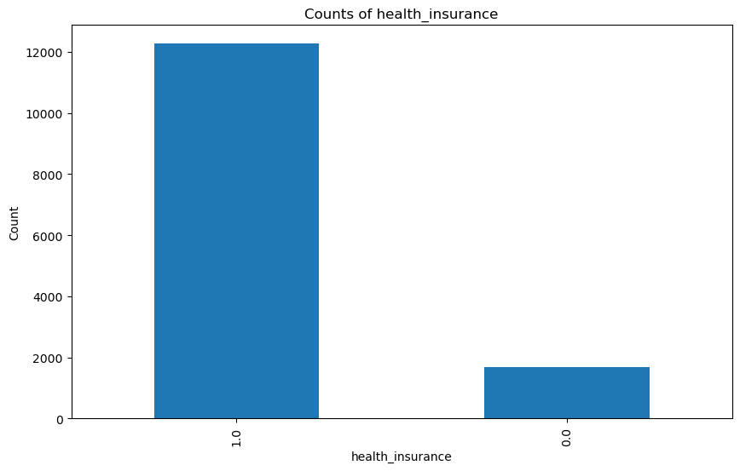
This plot is used to visualize the distribution of health insurance status among individuals in the dataset.The plot displays two bars: one for the "0" category and another for the "1" category, where "0" indicates no health insurance and "1" indicates having health insurance. The y-axis represents the frequency or count of individuals.
DISTRIBUTION OF HEALTH INSURANCE STATUS

Slide 10
MODELS USED
Model 1:
Logistic regression
Model 2:
Decision Trees
Model 3:
Random Forest
The model appears to have reasonably balanced performance, with accuracy, precision, recall, and F1-score in the range of 0.75 to 0.77.
The decision tree classification model demonstrates moderate performance, with relatively balanced precision and recall for both classes, resulting in an accuracy of 71%.
The overall accuracy of 77% suggests that the model is performing reasonably well in predicting whether an individual has been vaccinated or not.
Model 4:
Ensemble methods
Model 5:
KNN
Model 6:
Bayes classification
The XGBoost model achieves balance in precision, recall, and F1-score for both classes, with a slight edge in identifying "Not Vaccinated." The 79% accuracy indicates reasonable predictive performance.
While the performance is not perfect, the models show an ability to correctly classify instances from both classes with a reasonable degree of accuracy of about 59%.
It achieved balanced performance with strong precision and recall for both vaccinated and non-vaccinated individuals. Comparable F1-scores, an accuracy of 73%, and consistent averages highlight its effective prediction capability.

Slide 11
CONCLUSIONS
The top-performing classifier is XGB classifier which prioritizes accuracy, highlights that the three most significant factors influencing the decision of individuals to receive the seasonal flu vaccine in 2009 were as follows:
Doctor recommendations - Seasonal flu vaccine was
recommended by doctor.
Perceived Risk of Contracting Flu without the Vaccine
Respondent's opinion about seasonal flu vaccine
effectiveness.

Slide 12
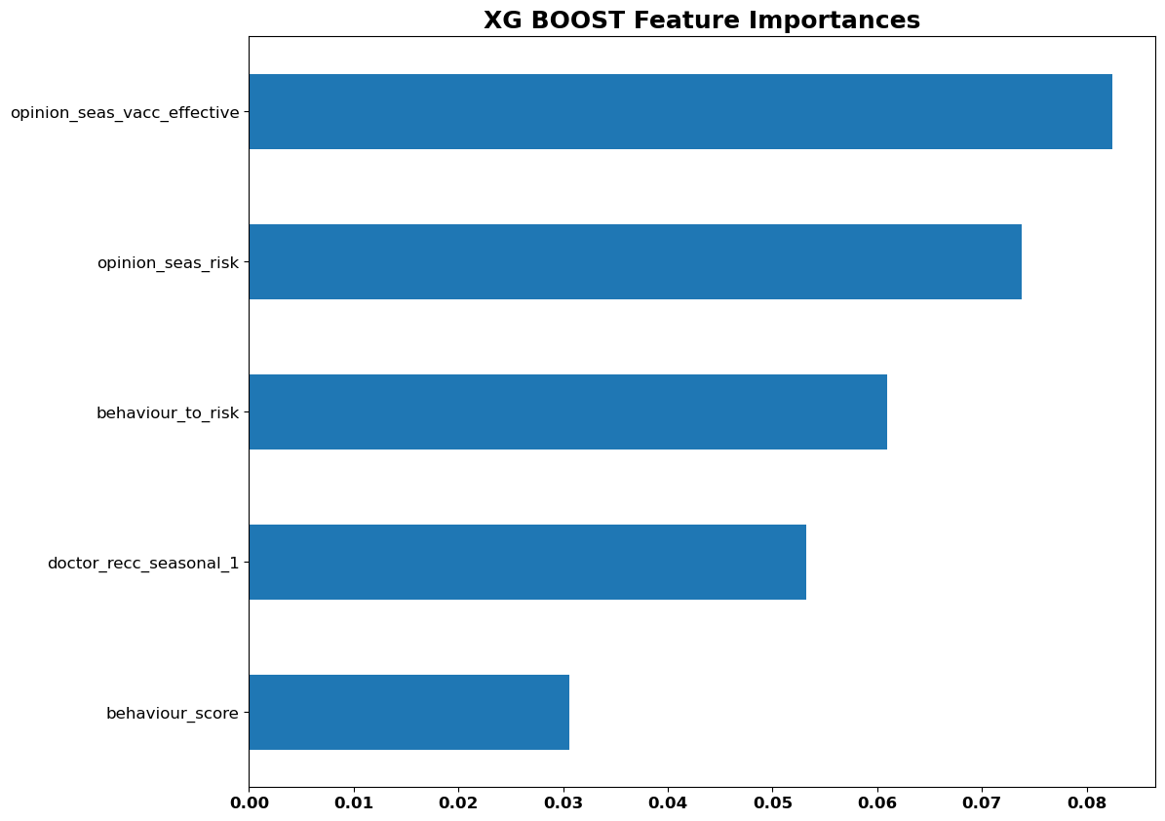
RESULTS
Here is a depiction of the prominent factors/features identified by the XGBoost classifier, which hold the potential to mitigate vaccine hesitancy.

Slide 13

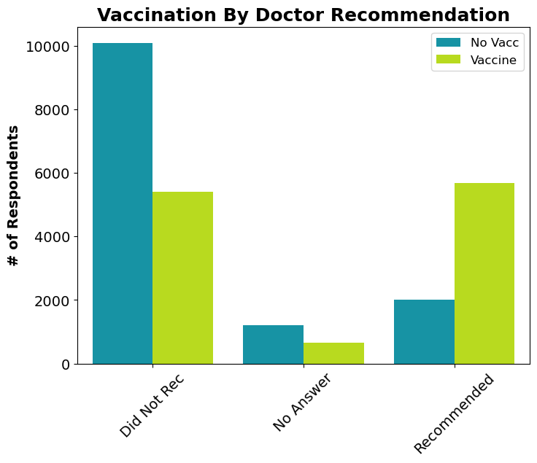
The primary influential factor in predicting vaccination behavior is receiving a recommendation for the flu vaccine from a doctor. Individuals who were advised by their physician to get vaccinated showed a significantly higher likelihood of having received the vaccine.

Slide 14
RECOMMENDATIONS
To enhance the uptake of seasonal flu vaccination, the following strategies could be considered by the government:
Enhance Public Awareness Regarding Vaccine Effectiveness: Efforts should focus on increasing public knowledge about the vaccine's effectiveness in safeguarding against the flu. These awareness initiatives could be executed at the community or national level. Disseminating credible evidence through channels like television or online advertisements can facilitate informed decision-making.
Encourage Regular Physician Recommendations: To bolster herd immunity, it is advisable for healthcare providers to consistently advise their patients to undergo seasonal flu vaccination annually. This personalized approach may yield better results compared to generalized vaccine promotion through alternative means. Nonetheless, comprehensive campaigns remain vital for reaching individuals who may not have routine access to healthcare services.
To elevate the overall vaccination rate against seasonal flu, initiatives should prioritize encouraging, educating, and ensuring healthcare access for the following demographics:
-Individuals aged 18 to 34
- Uninsured individuals
- Renters
- Communities of color
- Those with income below the poverty threshold
- Individuals without a high school diploma

